Slide 1
Digital Systems Design
Register Transfer Logic

Slide 2
Introduction
A digital system is a sequential logic system constructed with flip-flops and gates.
A sequential circuit can be specified by means of a state table.
To specify a large digital system with a state table would be difficult.
To overcome this difficulty, we use some modules which are constructed from such digital functions as registers, counters, decoders multiplexers, arithmetic elements and control logic.

Slide 3
Microoperation
It specifies the elementary operation to be performed on the information stored in registers.
There are four categories of microoperations:
Interregister-transfer
Arithmetic
Logic
Shift

Slide 4
Interregister Transfer
Information transfer from one register to another is designated in symbolic form by means of the replacement operator. The statement:
A ← B
Denotes the transfer of the contents of register B into register A.
The condition that determines when the transfer
is to occur is called a control function.
A control function is a Boolean function that is equal to 1 or 0.
The control function is included with
the statement as follows:
x’T₁: A ← B
Register B
x
Register A
T₁

Slide 5
Interregister Transfer
There are occasions when a destination register receives information from two sources, but evidently not at the same time. Consider two statements:
T₁: C ← A
T₅: C ← B
T₁ and T₅ are two different timing variables.
When T₅ = 1, register B is selected, but when T₁ = 1, register A is selected (because T₅ must be 0 when T₁ is 1).

Slide 6
Interregister Transfer
We need a quadruple 2-to-1 multiplexer in order to select register A or register B.
Register B
Register A
1
0
Select
2X1 MUX
Enable
T₅
Load
Register C
T₁

Slide 7
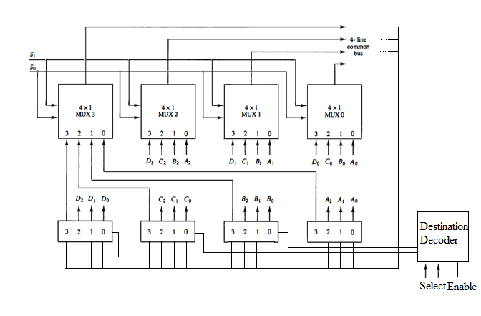
Interregister Transfer
For registers of n bits, n multiplexers are needed
to produce an n-line bus.
The n lines in the bus are
connected to the n inputs
of all registers.
Select source = 00 (Register A)
Select destination = 10 (Register C)

Slide 8
Interregister Transfer
A memory register or word is symbolized by the letter M.
Consider a memory unit that has a single address register, MAR.
A single memory buffer register MBR is used to transfer data into and out of the memory.
R: MBR ← M R is the control function that initiates the read operation.
W: M ← MBR W is the control function that initiates the write operation.
Read
MAR
Memory Unit
Write
MBR

Slide 9
Interregister Transfer
Inputs
W: M[A1]←B2
R: B0 ←M[A3]
A0
MUX
Read
A1
Address Bus
Memory Unit
A2
Write
A3
Outputs
Select
MUX
B0
Destination Decoder
Select
B1
Select
B2
B3

Slide 10
Fixed-Point Binary Data
A register with n flip-flops can store a binary number of n bits; each flip-flop represents one binary digit.
The sign of a number is a discrete quantity of information having two values: plus and minus.
These two value can be represented by a code of one bit.
0 for plus
1 for minus
To represent a sign binary number in a register, we need n = k +1 flip-flops, k flip-flops for the magnitude and one for storing the sign of the number.

Slide 11
Signed Binary Numbers
There are three different ways of representation:
Sign-magnitude
Sign-1’s complement
Sign-2’s complement
For example: the binary number 9 is written below in the three representations
+9 –9
Sign-magnitude 0 001001 1 001001
Sign-1’s complement 0 001001 1 110110
Sign-2’s complement 0 001001 1 110111

Slide 12
Arithmetic Subtraction
(±A) – (–B) = (±A) + (+B)
(±A) – (+B) = (±A) + (–B)
Changing a positive number to a negative number is easily done by taking its 2’s complement.
The subtraction with 1’s complement numbers is similar except for the end-around carry.
To avoid the end-around carry and the occurrence of a negative zero, we choose 2’s complement over 1’s complement.

Slide 13
Overflow
Two signed numbers, 35 and 40 are stored in two 7-bit registers.
The maximum capacity of the register is (2⁶ – 1) = 63 and the minimum capacity is – 2⁶ = – 64.
Since the sum of the numbers is 75, it exceeds the capacity of the register.
This overflow happens when both numbers are positive or negative.
+35 0 100011 – 35 1 011101
+40 0 101000 – 40 1 011000
+75 1 001011 – 75 0 110101

Slide 14
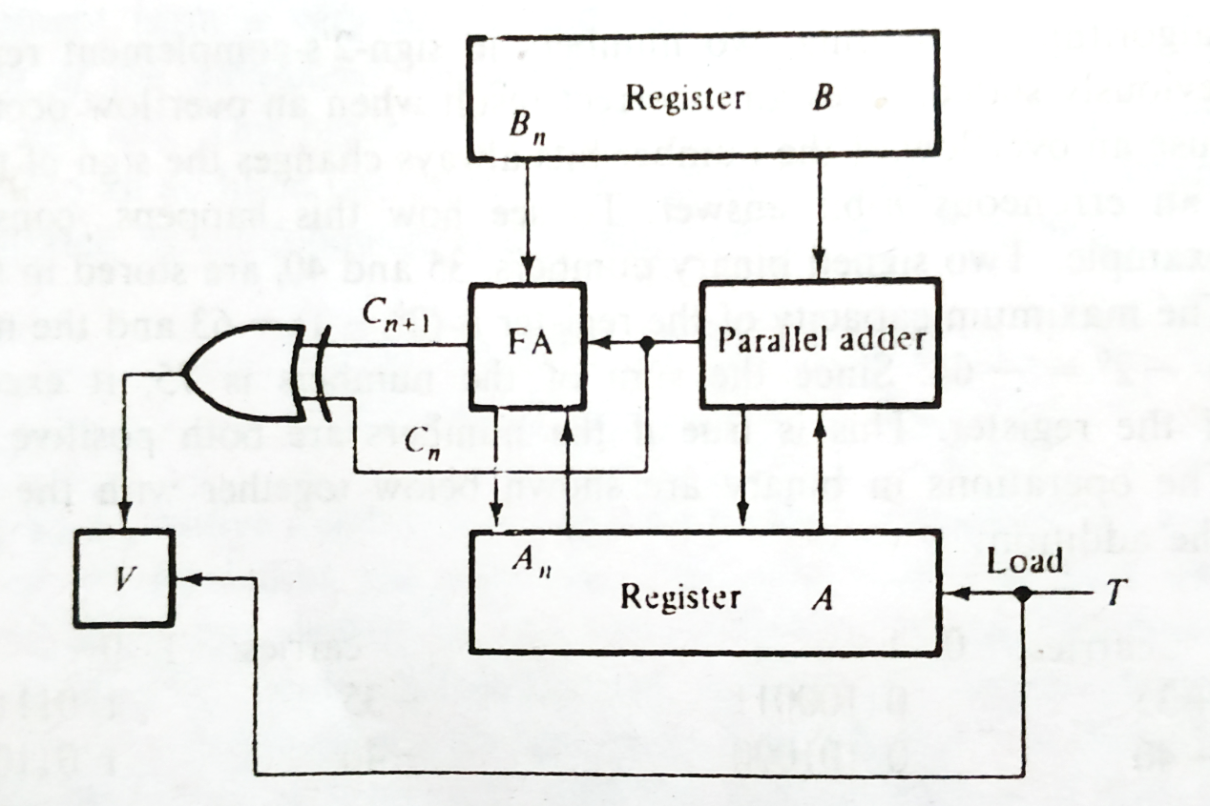
Overflow
An overflow condition can be detected by observing the carry into the sign-bit position and the carry out of the sign-bit position.
If these two carries are not equal, an overflow condition is produced.

Slide 15
Instruction Codes
A program is a set of instructions stored in memory.
The control reads each instruction from memory and places it in a control register.
The control interprets the instruction and proceeds to execute it by issuing a sequence of control functions.
An instruction code is a group of bits that tell the computer to perform a specific operation.
It is usually divided into parts, each having its own particular interpretation.
The most basic part of an instruction code is its operation part which defines add, subtract, multiply, shift and complement.

Slide 16
Instruction Codes
The number of bits required for the operation part of the instruction code is a function of the total number of operations used.
It must consist of at least n bits for a given 2^{n} or less distinct operations.
For example a computer using 32 distinct operations, one of them being an ADD operation.
The operation code may consist of five bits, with a bit configuration 10010 assigned to the ADD operation.
The instruction code must specify not only the operation but also the registers where the operands are to be found as well as the register where the result is to be stored.

Slide 17
Instruction Codes Formats
The bits of the instruction are sometimes divided into groups that subdivide the instruction into parts.
Each group is assigned a symbolic name, such as operation code part or address part.
Operation-code
Implied
Operation-code
Operand
Immediate operand
Operation-code
Address of Operand
Direct address

Slide 18
Instruction Codes Formats
Let us assume that we have a memory unit with 8 bits per word and that an operation code contains 8 bits.
Address
Memory
25
00000001
Op-code = 1
A ← R
.
.
.
35
00000010
Op-code = 2
A ← Operand
36
00101100
Operand = 44
.
.
.
45
00000011
Op-code = 3
A ←M[Address]
46
01000110
Address = 70
.
.
70
00011100
Operand = 28

Slide 19
Macrooperations Vs Microoperations
A statement that requires a sequence of microoperations for its implementation is called a macrooperation.
If the register-transfer statement can be executed with a single control function, it represents a microoperation.
If the hardware execution of the statement requires two or more control functions, the statement is taken to be a macrooperation.
For example: A ← operand
This statement is a macroperation because it specifies a computer instruction that performs several microoperations.

Slide 20
Design of a Simple Computer
Symbol | Number of bits | Name of register | Function
MAR | 8 | Memory address register | Holds address for memory
MBR | 8 | Memory buffer register | Holds contents of memory word
A | 8 | A register | Processor register
R | 8 | R register | Processor register
PC | 8 | Program Counter | Holds address of instruction
IR | 8 | Instruction register | Holds current operation code
T | 3 | Timing Counter | Sequence generator
Memory unit
256 X 8
PC
MAR
IR
Operation decoder
MBR
q₃
q₂
q₁
t₇
t₀
A
Op-code | Mnemonic | Description | Function
00000001 | MOV R | Move R to A | A ←R
00000010 | LDI OPRD | Load OPRD into A | A ←OPRD
00000011 | LDA ADRS | Load operand specified by ADRS into A | A ←M[ADRS]
Timing decoder
R
T

Slide 21
Instruction Fetch Cycle
Program counter PC must be initialized to contain the first address of the program stored in memory.
The timing variables t₀, t₁ and t₂ out of the timing decoder are used as control functions to sequence the microoperations for reading an operation code and placing it into instruction register IR.
t₀ : MAR ← PC transfer op-code address
t₁: MBR ← M, PC ← PC + 1 read op-code, increment PC
t₂: IR ← MBR transfer op-code to IR

Slide 22
Execution of Instructions
The control uses the q_{i} variables to determine the next microoperations in sequence.
The MOV R instruction has an operation code that makes q₁ = 1.
During timing variable t₃, the execution of this instruction requires:
q₁t₃ : A ← R, T ← 0
T is cleared to make the control go back to produce timing variable t₀.

Slide 23
Execution of Instructions
The LDI OPRD instruction has an operation code that makes q₂ = 1.
During timing variables t₃, t₄ and t₅ the execution of this instruction requires:
q₂t₃ : MAR ← PC transfer operand address
q₂t₄ : MBR ← M, PC ← PC + 1 read operand, increment PC
q₂t₅ : A ← MBR, T ← 0 transfer operand, go to fetch cycle
T is cleared to make the control go back to produce timing variable t₀.

Slide 24
Execution of Instructions
The LDA ADRS instruction has an operation code that makes q₃ = 1.
During timing variables t₃, t₄, t₅, t₆ and t₇ the execution of this instruction requires:
q₃t₃ : MAR ← PC transfer next address
q₃t₄ : MBR ← M, PC ← PC + 1 read ADRS, increment PC
q₃t₅ : MAR ← MBR transfer operand address
q₃t₆ : MBR ← M read operand
q₃t₇ : A ← MBR, T ← 0 transfer operand to A, go to fetch cycle
T is cleared to make the control go back to produce timing variable t₀.

Slide 25
Execution of Instructions
FETCH | t₀ : | MAR ← PC
 | t₁: | MBR ← M, PC ← PC + 1
 | t₂: | IR ← MBR
MOV | q₁t₃ : | A ← R, T ← 0
LDI | q₂t₃ : | MAR ← PC
 | q₂t₄ : | MBR ← M, PC ← PC + 1
 | q₂t₅ : | A ← MBR, T ← 0
LDA | q₃t₃ : | MAR ← PC
 | q₃t₄ : | MBR ← M, PC ← PC + 1
 | q₃t₅ : | MAR ← MBR
 | q₃t₆ : | MBR ← M
 | q₃t₇ : | A ← MBR, T ← 0

Slide 26
Design of Computer
Now we need to design a combinational circuit for the list of control functions and microoperations for the digital system.
For example, in the previous table the instruction MAR ← PC is listed with three control functions, t₀, q₂t₃, q₃t₃.
The combined statement, x₁ is: t₀ + q₂t₃ + q₃t₃ : MAR ← PC
x₂ = q₃t₅ | MAR ← MBR
x₃ = t₁ + q₂t₄ + q₃t₄ | PC ← PC +1
x₄ = x₃ + q₃t₆ | MBR ← M
x₅ = q₂t₅ + q₃t₇ | A ← MBR
x₆ = q₁t₃ | A ← R
x₇ = x₅ + x₆ | T ← 0
x₈ = t₂ | IR ← MBR
PC
t₀
t₃
q₂
MAR
q₃
Load

Slide 27
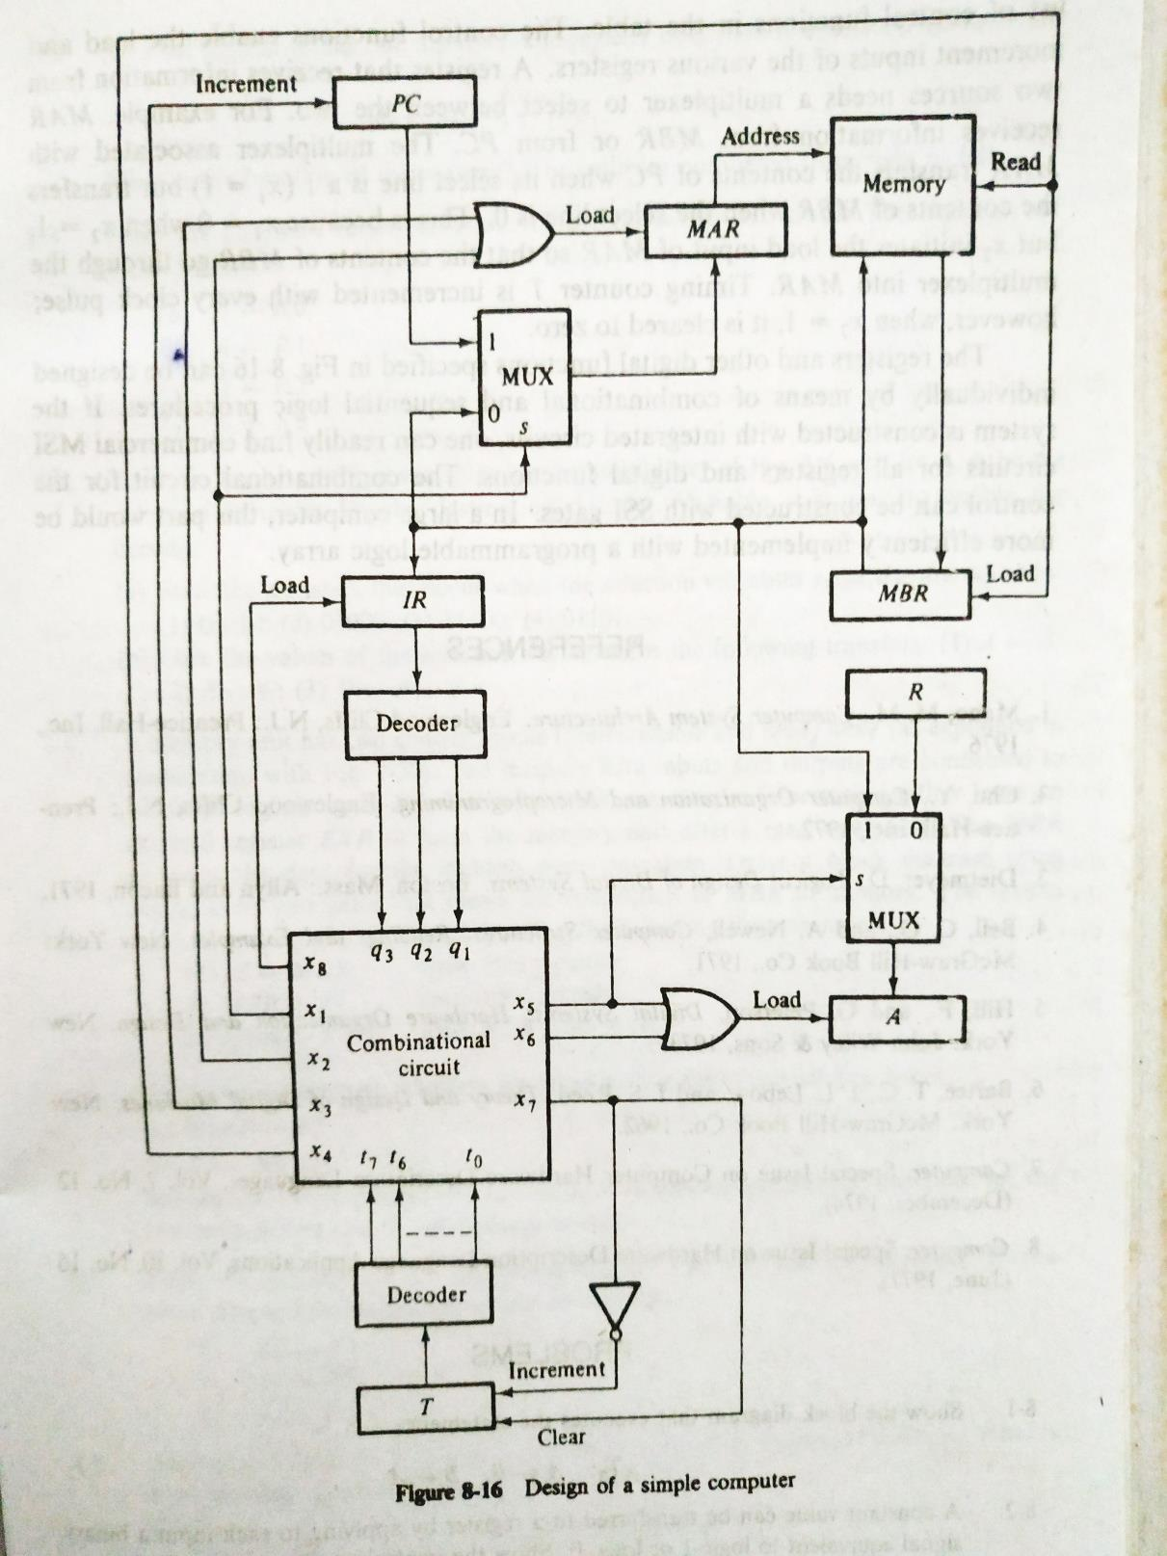
Design of Computer
In some cases a register that receives
information from two sources needs a
multiplexer to select between the two.
MAR receives information from MBR and PC.
When x₁ = 1, it receives from PC but
transfers the contents of MBR when the select
line is 0.

